Slide 1
Problems on Energy and Power Signals
Signals and Communication Systems (SCS)
Session-6

Slide 2



Problems on Energy and Power Signals
The value of power of given signal does not depend on frequency and phase components of the signal.
The value of power depends on scaling in amplitude and squaring (or higher powers) of the signal. However, the value of power does not depend on scaling in time (compression, expansion).
The value of energy does not depend on shifting, folding and combined shifting and folding of the signal.
However, the value of energy depends on scaling in time (compression, expansion) and amplitude and squaring of the signal.

Slide 3
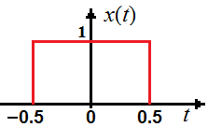
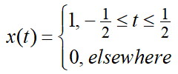
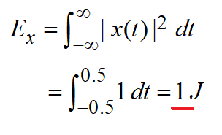
Ex2: A rectangular pulse having unit width, unit height centered at origin. Find its energy.
The functional representation
The energy of the signal

Slide 4
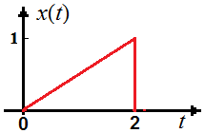
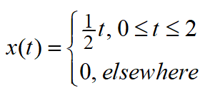
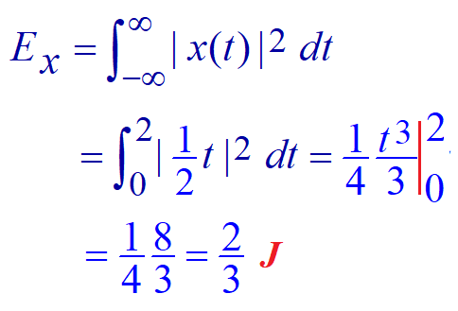
Ex2: Find energy of a signal shown in figure
Then the signal is represented
by

Slide 5





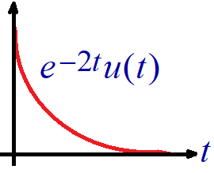

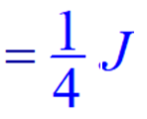
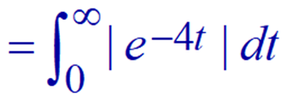
Ex3: Find energy and power of the following signals
(a) (b)
(c)

Slide 6
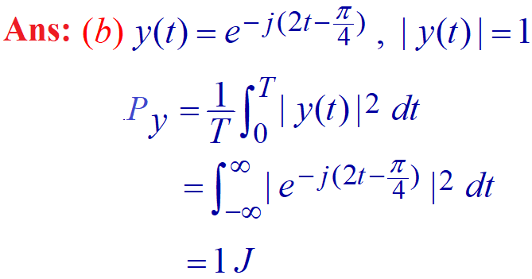


Slide 7

Ex4: Show that the delayed signal does not change the energy content.
Left an exercise

Slide 8

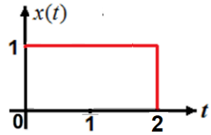






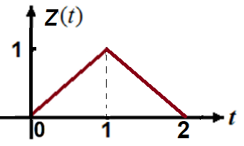

Slide 9

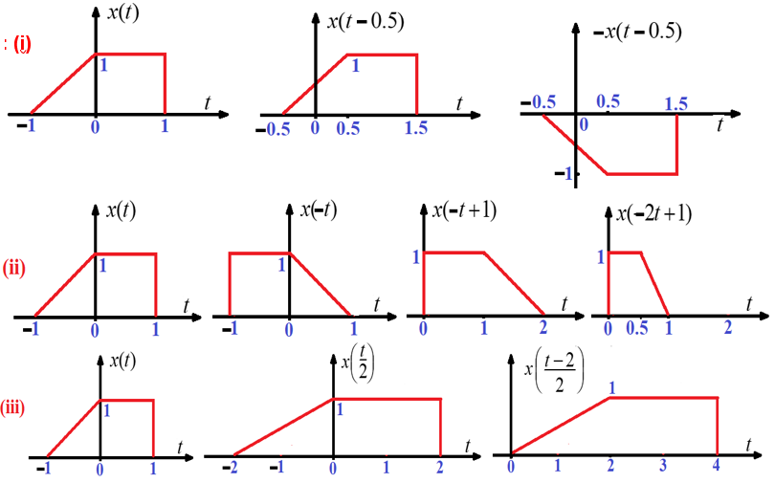

Slide 10
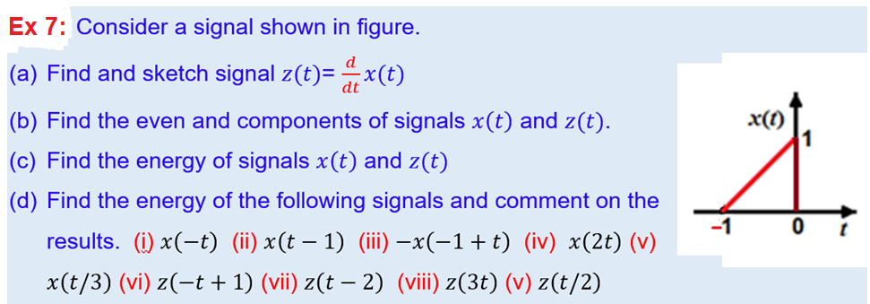
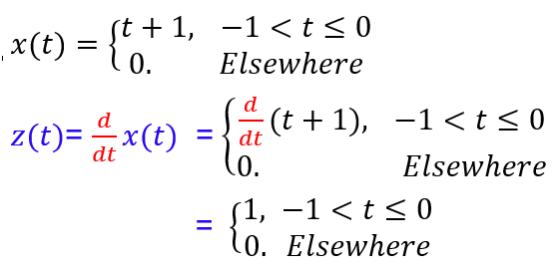
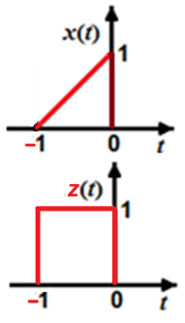

Slide 11

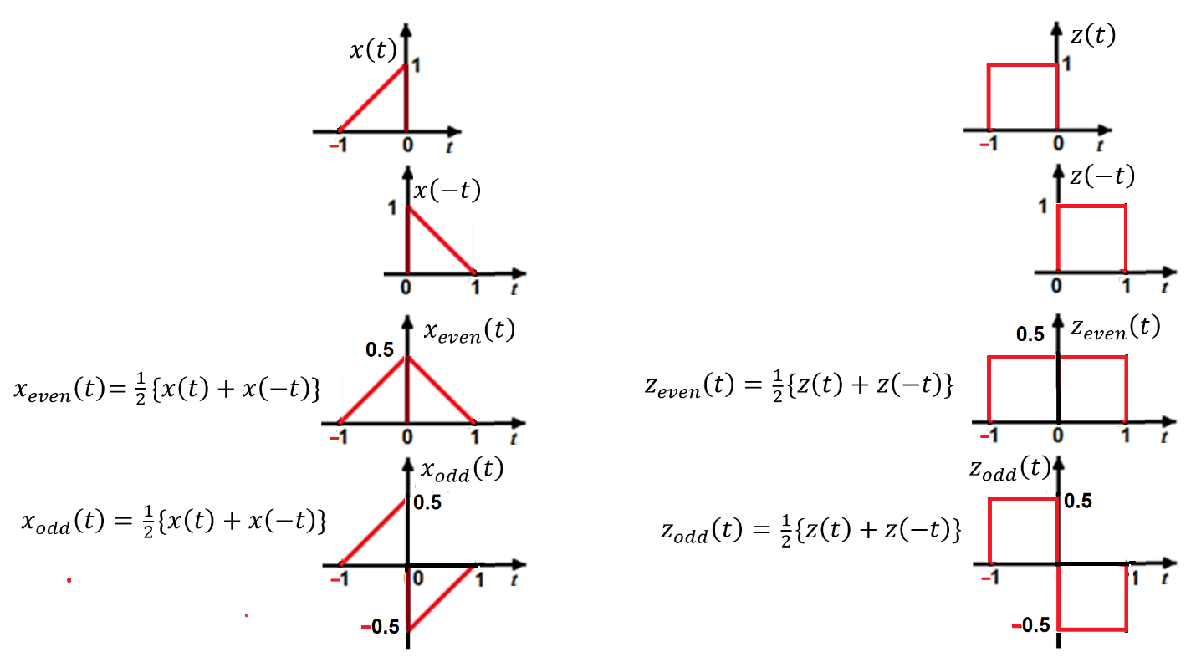
Even and odd components

Slide 12

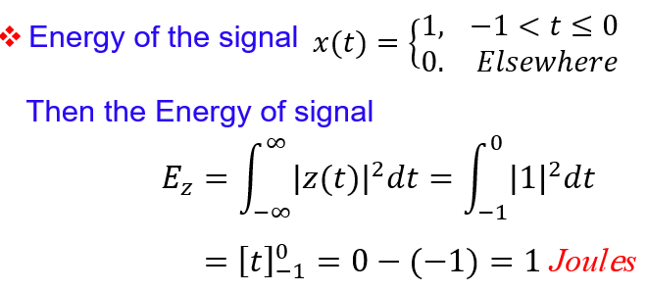

Energy: Energy does not change with time shifting

Slide 13



Slide 14
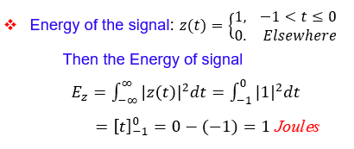
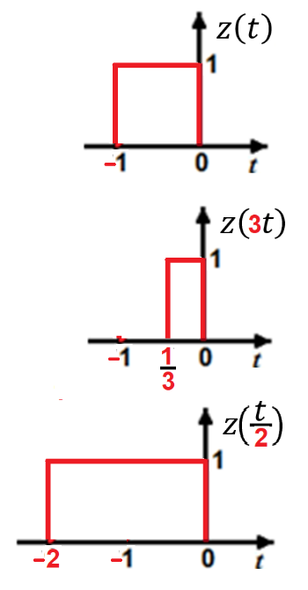

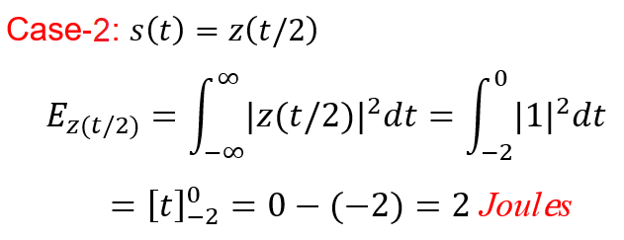

Slide 15
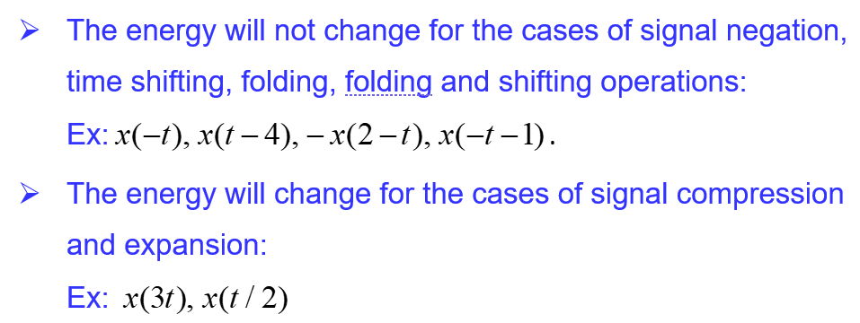
Comments on the energy calculations

Slide 16
End

